Slide 1
Biology
Unit 1: The Living Systems
Lesson 3: Mechanisms of Homeostasis
Notes:
The learning experiences in this unit prepare students for the mastery of
Performance Expectations
LS1-2 Develop and use a model to illustrate the hierarchical organization of interacting systems that provide specific functions within multicellular organisms.
LS1-3 Plan and conduct an investigation to provide evidence that feedback mechanisms maintain homeostasis.
ETS1-2 Design a solution to a complex real-world problem by breaking it down into smaller, more manageable problems that can be solved through engineering.
ETS1-3 Evaluate a solution to a complex real-world problem based on prioritized criteria and trade-offs that account for a range of constraints, including cost, safety, reliability, and aesthetics, as well as possible social, cultural, and environmental impacts.

Slide 2


Can You Explain It?
Unit 1 Lesson 3
Many people shiver when they have a fever, even though their body temperature is higher than normal. Why would your body respond to the increased internal temperature as though you were cold?
Your body has control systems that keep its internal environment stable.
Notes:
Build on Prior Lessons
In Lesson 2, students learned about how systems within an organism interact to carry out life functions. Lesson 3 builds on these concepts as students explore feedback loops and maintaining homeostasis.
Lesson Objective
Explain how positive and negative feedback loops help an organism to maintain homeostasis.

Slide 3
Control Systems in Organisms
Unit 1 Lesson 3
Homeostasis is the regulation and maintenance of the internal environment within the narrow ranges that are necessary to support life at the cellular level.
A stimulus is anything from the internal or external environment that causes an imbalance in the internal conditions of a cell, organ, organ system, or organism.
Hormones are chemicals secreted into the bloodstream by ductless endocrine glands.
The interaction between the receptor, the control center, and the effector is known as a feedback loop.

Slide 4
Control Systems in Organisms
Unit 1 Lesson 3
EXPLAIN
Use the Homeostatic Control Systems Diagram to explain how shivering can help body temperature return to normal.

Slide 5

Control Systems in Organisms Hands-On Activity: Modeling Feedback
Unit 1 Lesson 3
In this activity, you will balance a book on your head while walking.

Slide 6
Control Systems in Organisms
Unit 1 Lesson 3
In a negative feedback loop , a stimulus causes an imbalance in one direction.
This imbalance is detected by receptors that send information to the control center.
A positive feedback loop makes adjustments in the same direction as the stimulus.
Scientists sometimes refer to positive feedback loops as reinforcing loops, because they amplify the stimulus instead of counteracting

Slide 7
Control Systems in Organisms
Unit 1 Lesson 3
EXPLAIN
The body relies on positive and negative feedback loops to maintain homeostasis. One such feedback loop is used to maintain water balance in the body.
What type of feedback loop returns the body to homeostasis when it becomes dehydrated?
Use evidence from this lesson to support your answer.

Slide 8
Homeostasis in the Human Body Hands-On Lab: Negative and Positive Feedback
Unit 1 Lesson 3
Analyze data and generate graphs to determine whether a process is an example of a negative or positive feedback loop.

Slide 9
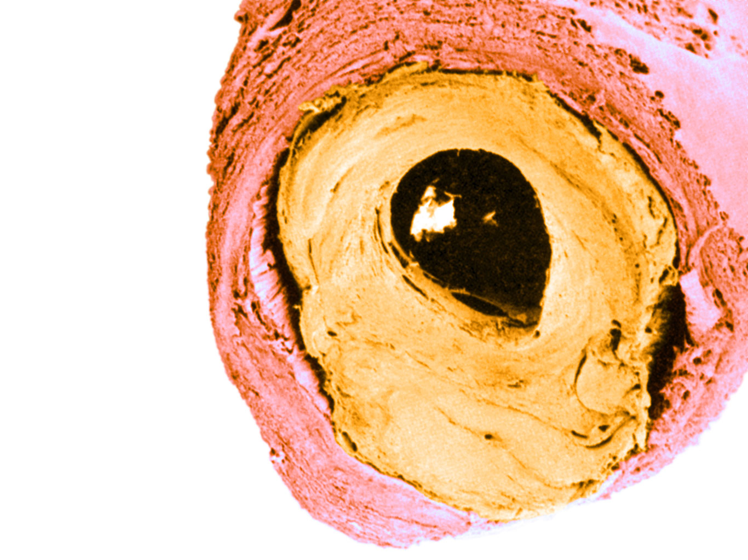
Homeostasis in the Human Body Cause and Effect
Unit 1 Lesson 3
Blood pressure depends on how elastic and unblocked the arteries are and on the strength of the heart contraction.
The less elastic the arteries and the more blockages that reduce blood flow, the harder the heart must pump.
Blocked Artery
If a person's blood pressure is too high or too low, how might the other organ systems in their body be affected?

Slide 10
Homeostasis in the Human Body Hands-On Lab: Investigating Homeostasis and Exercise
Unit 1 Lesson 3
Investigate how the circulatory system, respiratory system, and perspiration are affected by exercise.

Slide 11
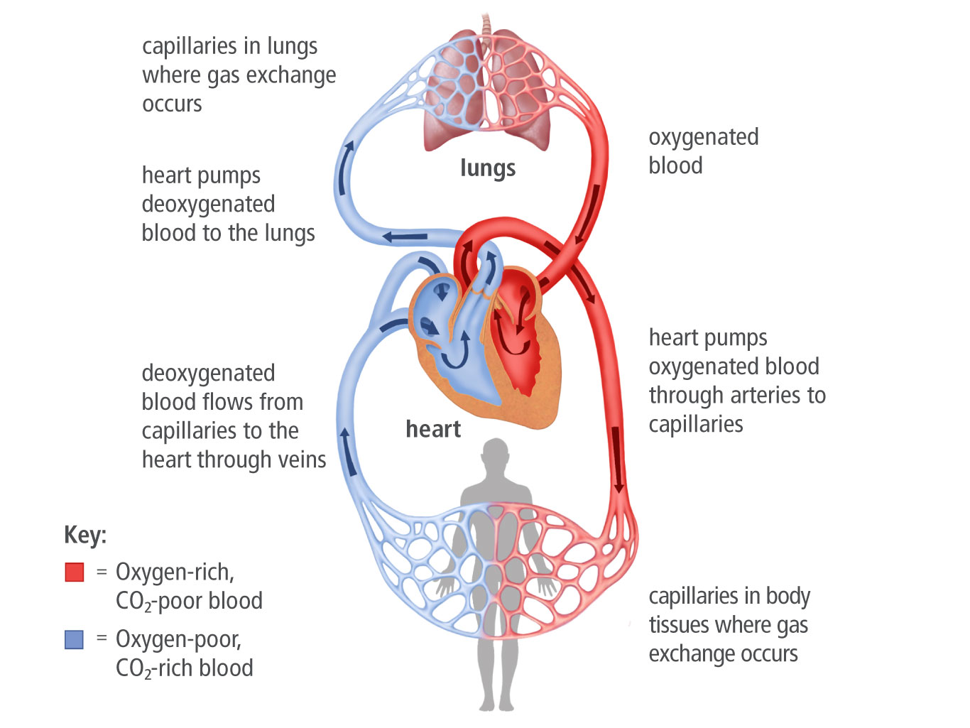
Homeostasis in the Human Body
Unit 1 Lesson 3
The circulatory system has three types of blood vessels: arteries, veins, and capillaries.
Arteries carry oxygen-rich, or oxygenated, blood away from the heart.
Veins are blood vessels that carry oxygen-poor, or deoxygenated, blood back to the heart.
Capillaries are responsible for delivering O₂ directly to cells and removing CO₂ and waste.

Slide 12
Homeostasis in the Human Body
Unit 1 Lesson 3
MODEL
Make a flow chart explaining how homeostasis is maintained when you become more active.
How do the respiratory and nervous system interact to maintain appropriate CO₂ and O₂ levels and prevent the blood from becoming too acidic?

Slide 13
Homeostasis in the Human Body
Unit 1 Lesson 3
Homeostatic mechanisms usually work quickly, but sometimes a change in the environment can occur too rapidly or be of too great a magnitude to be controlled through feedback mechanisms.
Disruptions can happen for several reasons, including failure of sensors to detect a change in the internal or external environment, sending or receiving the wrong message, serious injury, or disease-causing agents, such as bacteria or viruses.
COLLABORATE
With a partner, discuss whether your body's response to the common cold is an example of negative or positive feedback. Use evidence to support your claim.

Slide 14
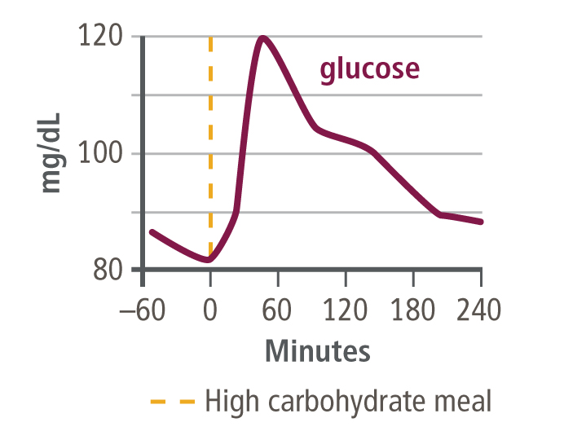
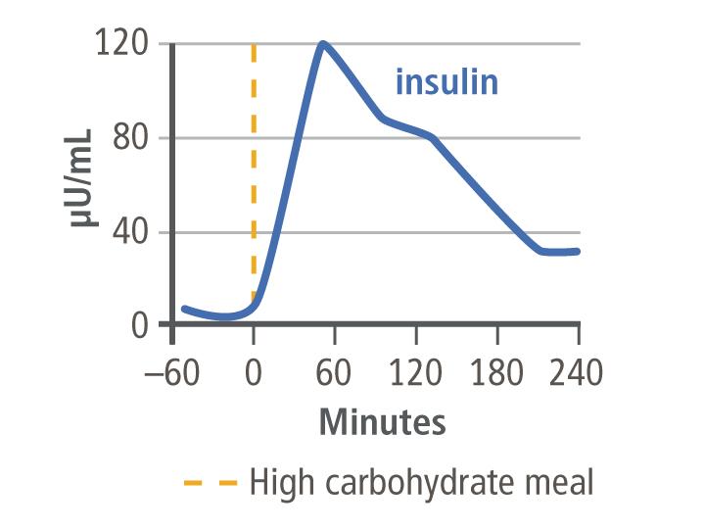
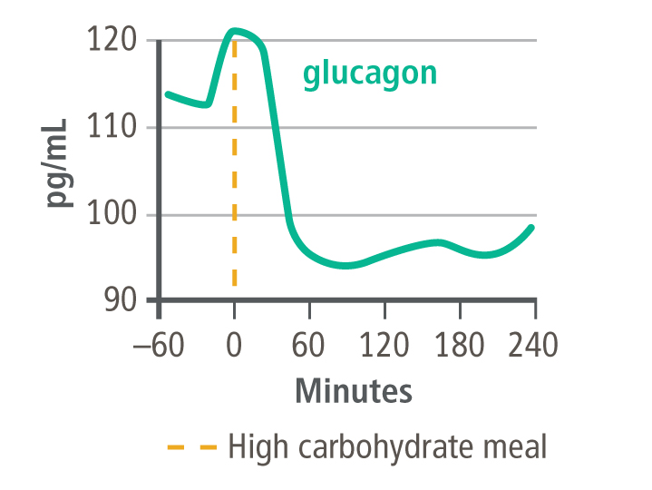
Homeostasis in the Human Body Data Analysis
Unit 1 Lesson 3
Blood glucose, insulin, and glucagon responses to a high-carbohydrate meal.
What is the relationship between blood sugar levels, insulin levels, and glucagon levels in the blood stream?
Type 1 diabetes occurs when the body's immune system destroys the ability of the pancreas to produce insulin. How would these graphs look different in a person with Type 1 diabetes?

Slide 15
Homeostasis in the Human Body
Unit 1 Lesson 3
EXPLAIN
Choose an example of a homeostatic variable from this lesson. Explain the feedback loop responsible for maintaining homeostasis for this variable.
Then describe how homeostasis for this variable can be disrupted.

Slide 16
Homeostasis in Other Organisms
Unit 1 Lesson 3
Many of the homeostatic processes you have learned about in humans are the same in other organisms as well. However, some organisms use different mechanisms to maintain homeostasis.
What other organisms do you think would have different homeostasis mechanisms from humans?
Why would this be an advantage in their environment?

Slide 17
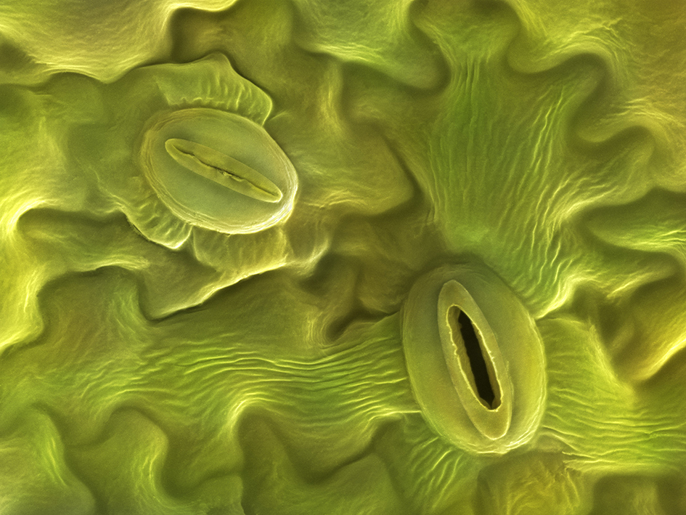
Homeostasis in Other Organisms
Unit 1 Lesson 3
Plants take in carbon dioxide for photosynthesis and give off oxygen as a waste product.
In plants, like in humans, homeostatic mechanisms regulate gas exchange.
Gases are exchanged through structures called stomata (singular, stoma).

Slide 18
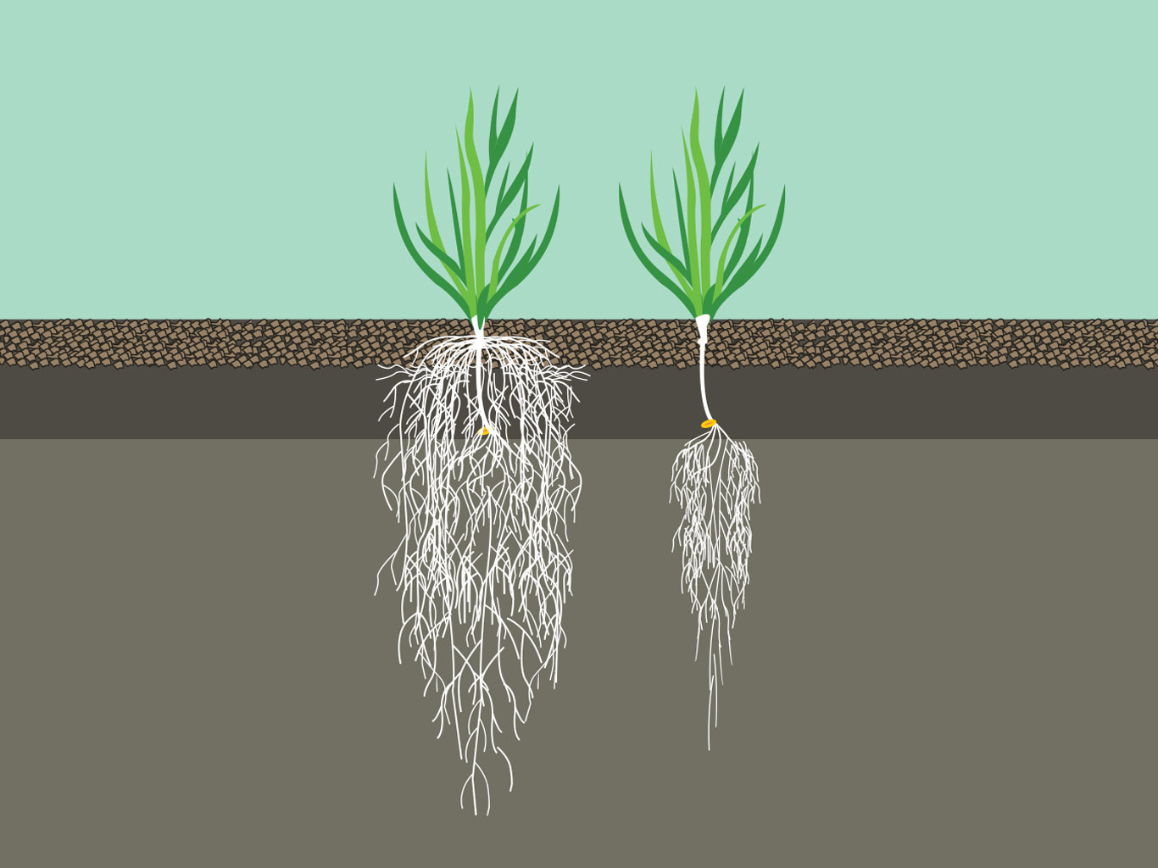
Homeostasis in Other Organisms Stability and Change
Unit 1 Lesson 3
MODEL
Make a model demonstrating how this feedback mechanism helps a plant maintain homeostasis during a drought.
The root growth of the plant on the right has been affected by drought.

Slide 19
Homeostasis in Other Organisms
Unit 1 Lesson 3
Not all feedback loops involve nerve impulses or hormones. Thermoregulation maintains a stable body temperature under a variety of conditions.
When ectotherms become too cold, they move to a warmer environment. When they become too hot, they move to a cooler environment. This behavior helps them maintain homeostasis.
Is thermoregulation an example of negative or positive feedback?

Slide 20
Homeostasis in Other Organisms
Unit 1 Lesson 3
When you live in a watery environment, you must have a strategy to maintain water and salt balances.
If you live in salt water, your environment is constantly trying to dehydrate you. If you live in fresh water, your body acts like a permanently thirsty sponge.
A saltwater fish swims into a river delta, where the salt concentration is lower than in normal salt water. This would disrupt its osmotic balance.
How will the fish's body restore homeostasis?

Slide 21
Homeostasis in Other Organisms
Unit 1 Lesson 3
EXPLAIN
Make a flow chart modeling a homeostatic mechanism in an animal and how it can be disrupted.
In your flow chart, note the stimulus, receptor, control center response, and effector for the feedback loop.

Slide 22
Unit 1 Lesson 3
Continue Your Exploration
Choose one of the paths below to continue your exploration:
Disorders of the Endocrine System
Investigating Homeostasis and Exercise
Explaining Homeostasis

Slide 23
Can You Explain It?
Unit 1 Lesson 3
Refer to the notes in your Evidence Notebook to explain each of the following questions. Use evidence from the lesson to support your claims.
Why do you shiver when you have a fever?
Is this response an example of positive or negative feedback? Why?
How does a fever disrupt homeostasis? Use the terms stimulus, control center, set point, receptors, effectors and imbalance in your answer.

Slide 24
Image Credits
Unit 1 Lesson 3
stomata ©Power and Syred/Science Source; root system comparison ©marinagluxova30/Fotolia; atherosclerosis ©Colorization by: Mary Martin/Science Source; woman drink outdoors ©Hero Images/Alamy

